Slide 1

National AIDS Control Program 20-year of battle against HIV/AIDS
Babita, Honey, Shriyuta
MPH (2017-19)

Slide 2
Content
History and burden of disease
Timeline of the NACP
Organizational structure of NACO ( 2014-MERGING WITH NHM)*
Program components
Finance
Human resources
Infrastructure (LABS,ICTC-PTCTC)
Leadership/governance
Information system
Service delivery (disability, nutrition)
Supply
Major stakeholders and their role vulnerable groups
Laws
Program achievements and GLOBAL+ NATIONAL (909090) goals
NACP in the context of SDGs, NHP-2017, Ayushman Bharat (oope*1)
Laws anti-discrimination s the Human Immunodeficiency Virus and Acquired Immune Deficiency Syndrome (Prevention and Control) Bill (the Bill) by Ghulam Nabi Azad
Emerging issues vis-à-vis NACP (AIDS act, unnao case-govt lethargy, hivdr, pharma monopoly- https://economictimes.indiatimes.com/industry/healthcare/biotech/pharmaceuticals/activists-cry-foul-over-new-hiv-drug-monopoly/articleshow/56191981.cms
Notes:
*e National Democratic Alliance (NDA) government has merged the country’s AIDS control department with another department in the health ministry in a move that seems to be prompted by a desire to shrink government but which, activists claim, will dilute the focus and reduce the efficacy of the successful Department of Aids Control, better known as the National Aids Control Organization (Naco).
The change will mean that India’s HIV prevention efforts will now be implemented under the National Health Mission (NHM), and not by a specific department.
According to people in the health ministry, the change is in keeping with Prime Minister Narendra Modi’s desire to shrink government, as exemplified in a slogan he popularized, “Minimum government, maximum governance”. Health minister Harsh Vardhan and mission director of NHM, Amit Kumar Ghosh, did not respond to calls or messages.
A senior official in the health ministry confirmed that the AIDS control department was being merged.
“Yes. We have been notified last week. In essence, the structure of the organization will remain the same but the department will not have a special secretary any more. The government felt there was no need for a special department. I am, however, not privy to the exact reasoning behind this decision,” added this person who spoke on the condition of anonymity.
Senior officials at Naco said they weren’t aware of the change.
Naco was created in 1992 to steer the country’s fight against HIV/AIDS. The Department of Aids Control has a secretary level official heading it.
Public health experts argue that the proposed merger of the AIDS response programme with NHM will dilute the specificity of community-based responses and will make invisible marginalized groups such as men who have sex with men and commercial sex workers.
The decision comes a month after health minister Vardhan’s controversial statements about sex education and the use of condoms.
“We have barely managed to get the programme running. We are still dealing with issues like stigma, drug stock outs in various parts of the country because the money isn’t being channelled efficiently. A merger will just ensure the programme gets caught in bureaucratic hurdles,” said Leena Menghaney, lawyer with Access Campaign, Doctors Without Borders.
AIDS workers and activists across the country are demanding an immediate reversal of the decision that they say was taken without any consultation with stakeholders and civil society.
“The decision will push back all the progress made on HIV prevention and care, but also tarnish India’s global image as a leader in this area,” said Anandi Yuvaraj, member of the International Community of Women with HIV. Like Menghaney, she too believes the change will mean “no space under the big umbrella of the National Health Mission” for marginalized groups.
India has the third-highest number of people living with HIV in the world, according to Yuvaraj.
NACO data shows that India has over 2 million HIV affected people, with high prevalence among injecting drug users, commercial sex workers and men who have sex with men.
India reported its first HIV/AIDS case in 1986; given the rapid spread of HIV/AIDS, the government created a National AIDS Committee which then felt the need for a separate department to draw up and implement a nationwide programme.
NACO, under the Department of Aids Control, was established in 1992 as a separate division of the health ministry.
It currently runs 35 state-level AIDS control societies, through which India’s national HIV/AIDS prevention programmes are implemented.
http://www.asianage.com/india/all-india/110218/bangarmau-living-under-the-shadow-of-an-hiv-scare.html
https://www.hindustantimes.com/lucknow/bring-aids-control-under-national-health-mission-uttar-pradesh/story-lIeavsxntUlwZjnXOqH3FP.html
https://www.ncbi.nlm.nih.gov/pmc/articles/PMC3310301/#!po=37.8906 NGO
https://www.smh.com.au/world/india-passes-hivaids-antidiscrimination-law-but-stigma-endures-20170418-gvmxq6.html
s the Human Immunodeficiency Virus and Acquired Immune Deficiency Syndrome (Prevention and Control) Bill (the Bill) by Ghulam Nabi Azad http://www.loc.gov/law/foreign-news/article/india-law-bans-discrimination-against-aids-patients/
https://blog.ipleaders.in/leprosy-is-curable/ LAWS ANTI DIS LEP Mrs Arulanantham pointed out that were also other legal hurdles to overcome, such as the religious marriage bills that allow discrimination. The newly-introduced Sikh Marriages Bill, 2016, that is currently going through Parliament, allows the dissolution of marriage when a spouse is suffering from ‘a virulent and incurable form of leprosy’. https://www.leprosymission.org.uk/news-and-resources/news/indias-repeal-of-1898-lepers-act-is-positive-step/
*1 http://medind.nic.in/iby/t07/i12/ibyt07i12p509.pdf economic cost of hiv

Slide 3
What is left?
NACO components in depth (NBTC, DIVISIONS)
MEDICINE REGIME
AFFORDABLE DRUGS INDIA SENT TO AFRICA
Labs ictc art etc infra,
Finance? Budget outlay merging with NHM
ECONOMIC COST OF HIV AIDS
Social and financial benefits to PLHIV?

Slide 4
History of HIV-AIDS in India
First case of HIV (HIV-1) diagnosed in Chennai (1986)
National AIDS Committee (1987)
AIDS Bhedbhav Virodhi Andolan (AIDS Anti-Discrimination Movement) in 1989
Naz Foundation and self-help NGOs like the Indian Network for Positive People [INP+] got involved in advocacy, medico-legal support
National AIDS Control Organisation [NACO], was formed in 1992 as a semi-autonomous ‘temporary project management organisation’
IDA credit of 84 million USD to start the first National AIDS Control Program.
NACP I (1992-1999) drew upon the demonstrated success (in the US, Europe, and Sub Saharan Africa) of HIV prevention through of Targeted Intervention [TI]- involvement of NGO to reach HRGs funded by WB
NACP II (1999-2006)
was launched with World Bank credit support of USD 191 million
Naz Foundation (2002) starts campaign to overturn the ban on homosexuality in India was supported in the Delhi High Court's ruling after seven years
Notes:
Early studies have indicated the presence of both HIV-1 and HIV-2 in India [3, 6]. Subsequent studies further emphasized a predominance of subtype C strains in India
International Development Assiatance

Slide 5
National AIDS Prevention and Control Policy (2002), Adoption of National Blood Policy, National Anti-Retroviral Treatment (ART) program (roll out of free ART in 2004)
2009
Delhi HC decriminalizes homosexuality.
NACP III (2007-2012)
13 mental health professional file SLPs against section 377 in 2011
2014
Trans community recognized as the third gender by SC
2013
SC overturns HC’s decision
NACP IV (2012-2017)
2017
The Human Immunodeficiency Virus and Acquired Immune Deficiency Syndrome (Prevention and Control) Bill passed
2018
ICD-11: WHO and ISP classify gender dysphoria as a sexual health condition and NOT a mental health condition .
2018
Homosexuality decriminalized by SC

Slide 6
What is HIV/AIDS?
HIV infection is a profound immunodeficiency state with clinical manifestations in nearly all systems of the body.
There are 2 types of Human immunodeficiency virus (HIV) viz. HIV type I (HIV‐1) and HIV type 2 (HIV‐2). The most common cause of HIV disease throughout the world is HIV‐1 which comprises of several subtypes with different geographic distributions. HIV type 2 (HIV‐2) is endemic in West Africa and has spread in the last decade to India and Europe.
One of the unique characteristics about the condition is that the duration of time from initial infection to AIDS can vary from 3 years to several decades.
Diagnostic modalities:
It is categorized as a disease condition when CD 4 < 200 cells/mm, ALT/AST, ALP, urinalysis, ELISA, Western blot
Treatment:
Anti-retroviral therapy, Highly reactive ART, CPT (for opportunistic infections), PrEP
NRTI (Zidovudine ,Lamivudine, Stavudine)
NNRTI Nevirapine, Efavirenz)
INTEGRASE INHIBITORS (Raltegravir),
PI (Indinavir Nelfinavir)
CCR5 antagonists Maraviroc Foseamprenavir)
Notes:
Cotrimoxazole prophylaxis

Slide 7
Staging of the condition
Clinical Stage I and II if CD4 < 350 cells/mm3
Asymptomatic
Persistent generalized lymphadenopathy
Unexplained moderate weight loss etc
Start ART
Clinical Stage III and IV
Unexplained 2 severe weight loss (>10% of presumed or measured body weight)
Unexplained chronic diarrhoea for longer than one month Unexplained persistent fever (above 37.5OC intermittent or constant for longer than one month) Persistent oral candidiais
Oral hairy leukoplakia
Pulmonary tuberculosis etc
Start ART irrespective of CD4 count

Slide 8
Objectives of ART (ART to be started when CD4 count <350cells/mm3; revised in 2014; )
• Clinical goals : Prolongation of life and improvement in quality of life
• Virological goals: Greatest possible reduction in viral load for as long as possible
• Immunological goals: Immune reconstitution that is both quantitative and qualitative
• Therapeutic goals: Rational sequencing of drugs in a fashion that achieves clinical, virological and immunological goals while maintaining treatment options, limiting drug toxicity and facilitating adherence
• Reduction of HIV transmission in individuals: Reduction of HIV transmission by suppression of viral load

Slide 9
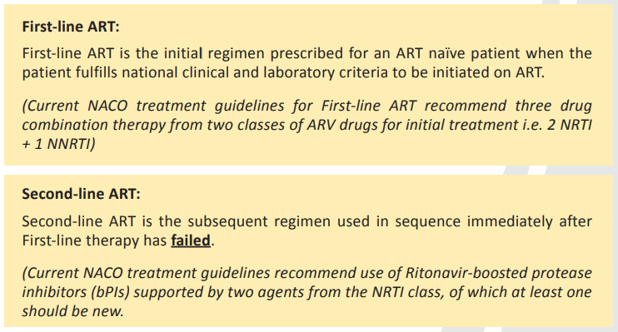
ART/HAART is a combination of at least three drugs from different groups
Notes:
Third line

Slide 10
Burden of disease
Adult HIV prevalence (15-49 years)
Declined from 0.38% in 2001-03—which is when the epidemic is estimated to have peaked—to 0.34% in 2007 and reaching 0.26% in 2015
Estimated number of people living with HIV (PLHIV)
2.1 million
New HIV infections
10,400 among children) in 2015, demonstrating a 66% decline in new infections from 2000 and 32% decline from 2007
Children below 15 years of age account for 6.54% of all HIV infections and 40.5% (856,000) are females in 2015

Slide 11
Prevalence in HRGs
TG is 8.82% and while among long distance truckers and single male migrants it is 0.99% and 2.59% respectively. There is limited information on trends of HIV in these groups in 2015.
Incidence of HIV + Tb infection
6.6 per 100,000 population in 2016
ANC
High prevalence ANC sites with HIV prevalence of 1% or more has nearly halved from 2003 to 2014-15.
Annual AIDS-related deaths
Estimated to have declined consistently by 54% from 2007 to reach 67,600 in 2015, as the national treatment program has scaled up

Slide 12
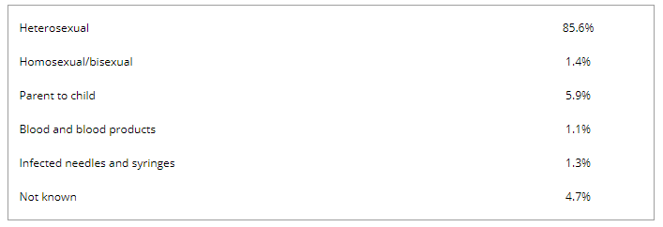
HIV prevalence at the National level
(2014-15)
Subgroups | HIV prevalence in India (%)
ANC | 0.29
FSW | 2.2
MSM | 4.3
TG | 7.5
IDU | 9.9
Upto 2013
Source: NACO Annual report 2016-17
HIV/AIDS in India: an overview of the Indian epidemic
RS Paranjape
SJ Challacombe
First published: 25 April 2016
https://doi.org/10.1111/odi.12457

Slide 13
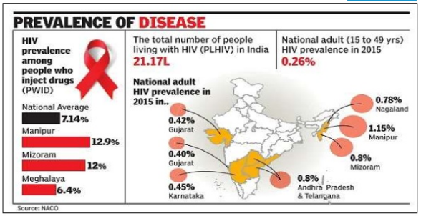
Though the overall national prevalence is low, six states have reached high prevalence (>1%): Manipur, Nagaland, Andhra Pradesh, Tamil Nadu, Karnataka and Maharashtra. Certain districts in Goa and Gujarat have also reported high prevalence.
Notes:
The trends across the country show that there is no explosive HIV epidemic in India as a whole. However, there are serious sub-national epidemics in various parts of the country with rapid spread and evidence of high prevalence of HIV among both Sexual Transmitted Infections (STI) and antenatal clinic attendees in different sites located in States of Andhra Pradesh, Maharashtra, Tamil Nadu, Gujarat, Pondicherry, Assam, Bihar, Chhattisgarh, Delhi, Haryana, Himachal Pradesh, Kerala, Orissa, Goa and Manipur. In high prevalence states the epidemic appears to be spreading gradually from urban to rural areas and from high-risk behavior groups to the general population. The epidemic continues to shift towards women with an estimated 39% of the infected being women [17].
An explosive epidemic driven by intravenous drug use has unfolded in the state of Manipur (North East India) bordering Myanmar and is close to the Golden Triangle composed of Thailand, East Myanmar and West Laos and is the hub of international drug trafficking. A recent study documents two-third of HIV infections in this region of India are caused by subtype C and subtype B (Thai B) accounts for 20% of infections [15]. The presence of multiple subtypes circulating in Manipur suggests the likelihood of recombinant viruses evolving in this region. Indeed, this has been corroborated by a recent study which reported presence of B/C recombinants from this region [26]. Apart from north-eastern states there are also sporadic reports of the presence of A/C and B/C recombinants from West and South India

Slide 14
State categorization
Generalized/High‐prevalence States: where ‘transmission is sustained outside core groups’ and the prevalence among pregnant women is consistently over 1%.
Concentrated: where ‘transmission is not sustained outside core groups’ and the prevalence among pregnant women is below 1%, but core groups at high risk have prevalence >5% and
Low‐level: where the prevalence in high‐risk groups is <5% and prevalence among pregnant women <1%

Slide 15
District categorization
Category A: >1% ANC prevalence in district in any of the sites in the last 3 years.
Category B: <1% ANC prevalence in all the sites during last 3 years with >5% prevalence in any HRG site (STD/FSW/MSM/IDU).
Category C: <1% ANC prevalence in all sites during last 3 years with <5% in all HRG sites, with known hot spots (Migrants, truckers, large aggregation of factory workers, etc.).
Category D: <1% ANC prevalence in all sites during last 3 years with <5% in all HRG sites with no known hot spots OR no or poor HIV data.
(ANC: Antenatal Clinic; HRG: High‐risk Group; STD: Sexually Transmitted Disease; FSW: Female Sex Worker; MSM: Men who have Sex with Men; IDU: Injecting Drug User.)

Slide 16
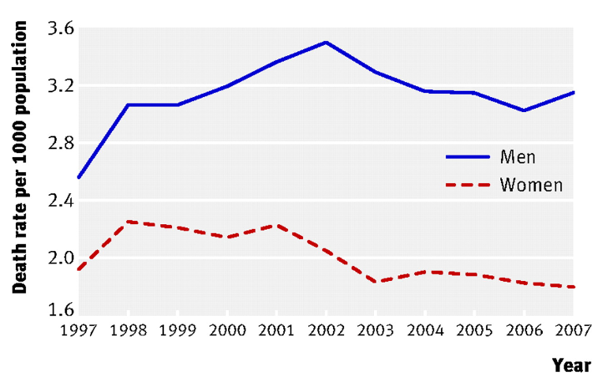
Epidemiological trend of HIV/AIDS
2007
Concentrated epidemic in India, with a very high prevalence among High Risk Groups
HSS 2010-11 estimates showed that all
states have shown less than 1% HIV prevalence among ANC clinic
attendees
1998
HIV infections reached a peak and have since declined by
60%, although the total number of HIV-positive persons remains stable
at 2.1 million
2008/2009
HIV estimates highlighted the declining
trend of annual AIDS deaths post 2004
Source: The Evolution Of Nacp: India's Attempt At Controlling The Hiv/ Aids Epidemic 7(1):7-9 · January 2018
HIV mortality and infection in India: estimates from nationally representative mortality survey of 1.1 million homes
BMJ 2010; 340 doi: https://doi.org/10.1136/bmj.c621 (Published 23 February 2010)Cite this as: BMJ 2010;340:c621
Notes:
– IDU (7.2%), MSM
(7.4%), FSW (5.1%) & STD clinic attendees (3.6%) and low

Slide 17
Stakeholders
MoHFW (NACO, NBTC, MoL, MoF,
MoI&B, MoWCD, MoCA, MoEA, MoHR
CDCSO, NPPI,ICMR
NHRC
Airport Authority of India, Border Service Forces
Vulnerable groups like CSWs, Truckers, IDIs, LGBTQIA+ community, Pregnant women, Children, Tribal communities
Trade and industrial organizations (CII, Pharmaceutical industry, Worker Unions)
International Unilateral and Multi-lateral agencies (WHO, WB, USAIDS, IAVI, GFATM)
Public and private Health providers (Doctors, Rehabilitation workers, Nurses)
Civil society (Naz Foundation, Saathi,
Print and Mass Media, Teachers, Human rights Activists, Lawyers, Law firms etc
Judicial bodies
Public Health laboratories
Blood banks
Notes:
International organization
World Health Organization (WHO)
When the National AIDS Control Programme was launched, WHO assisted the GoI in the formulation of strategy and plan for the implementation of prevention and control activities. In 1989, WHO supported the development of a medium-term plan for HIV/AIDS control in Maharashtra, Tamil Nadu, West Bengal, Manipur and Delhi, with a $10 million budget mobilised from different sources.
In 1990-91, WHO supported the launch of Unlinked Anonymous Surveillance to track the epidemic. In 1992, following the launch of National AIDS Project–I, WHO assisted in the planning and implementation of a spectrum of activities such as education and awareness programme, blood safety, hospital infection control, condom promotion, strengthening of clinical services for both STD and HIV/AIDS.
World Bank (WB)
In 1991 the Government of India and the World Bank expanded their collaboration in infectious diseases control programmes, and by 1992 the first National AIDS Control Project was launched with a World Bank credit of $84 million. For the second phase of the National AIDS Control Programme, a World Bank credit of $191 million was provided. The Bank has worked closely with the Government of India and other donors in the preparation of the third National HIV/AIDS Control Programme.
International AIDS Vaccine Initiative (IAVI)
The International AIDS Vaccine Initiative (IAVI) is a global not-for-profit public-private partnership working to accelerate the development of a vaccine to prevent HIV infection and AIDS for use throughout the world.
In India, IAVI has entered into an agreement with the Ministry of Health and Family Welfare through the National AIDS Control Organization (NACO) and the Indian Council of Medical Research (ICMR) to develop a vaccine for prevention of AIDS in India. IAVI also collaborates with the Ministry of Science and Technology, through the Department of Biotechnology and the Council of Scientific and Industrial Research, to advance research on the design and development of new AIDS vaccines.
UNAIDS(Joint United Nations Programme on HIV/AIDS)
Specifically, UNAIDS supports the national response to HIV and AIDS by promoting:
Strengthened leadership and resource mobilization for a broad-based response at all levels, including governments, civil society and people living with HIV.
Improved planning, financing, technical assistance and coordination at all levels for a sustainable multi-sectoral response to the epidemic, integrated with national development efforts.
Strengthened evidence base of the response through greater availability and use of strategic information from better monitoring and evaluation, surveillance, and resource tracking.
Enhanced human resources and robust delivery systems at all levels of government, civil society and other non-state partners.
Strengthened human rights-based and gender-responsive policies to reduce stigma and discrimination.
Increased coverage and sustainability of programmes for injecting drug users, men having sex with men and sex workers

Slide 18
NACP approaches in each phase
NACP-IV
NACP-III
1. Awareness generation, setting up surveillance system for monitoring HIV epidemic
2. Measures to ensure access to safe blood and preventive services for HRGs
1.Decentraliz-ation by means of formation of State AIDS control societies & District AIDS control societies
2. Involvement of NGOs/CBOs in policy making and service delivery
3. Reforming surveillance
4. Care and support for PLWHA
5. ART Program
6. National Blood Policy
1. Scaling up coverage of TIs among HRG, IEC (BCC practices, testing and counseling, and adherence, Opioid Substitution Therapy (OST)
2. Comprehensive Care, treatment and Support
Scaling up of ART including second line , management of opportunistic infections
3. Strengthening IC: Phased Integration of HIV services with the routine public sector health delivery systems, streamlining the supply chain mechanisms, quality control mechanisms and building capacities of governmental and non-governmental institutions and networks.
4. SIMS
Incidence analysis, identifying pockets of infection and estimating the burden of infection
1. Prevention and integrated Care, Support & Treatment (CST).
2. Computerized Information Management and Institutional Strengthening activities - provide the required technical, managerial and administrative support for implementing the program on local level.
3. Dedicated North-East regional Office
4. HIV Counseling and testing services
NACP-II
NACP-I
Notes:
NACP I Slowing down the spread of HIV infections so as to reduce morbidity, mortality and impact of AIDS
NACP III Epidemic? aimed at halting and reversing the HIV epidemic in India over its five-year period by scaling up prevention efforts among High Risk Groups (HRG) and General Population and integrating them with Care, Support & Treatment services.

Slide 19
Lessons learnt from Phase I & II & III
The epidemic continues to progress with the following characteristics
High risk groups to low risk groups
Urban to rural areas
High prevalence states to all states
High vulnerability of young persons and women
MSM and IDUs did not received appropriate attention
Growing number of people living with HIV/AIDS has increased the need for care, support and treatment.
Notes:
Generic ARVs were first introduced in India in 1994, and combination fixed dose ART regimens have been available since 1998

Slide 20
NACP-IV
To accelerate the process of epidemic reversal and further strengthen the epidemic response in India through a cautious and well-defined integration process over the five-year period, 2012- 2017.
Objectives:
Reduce new infections by 50% (2007 Baseline of NACP III)
Comprehensive care, support and treatment to all persons living with HIV/AIDS

Slide 22
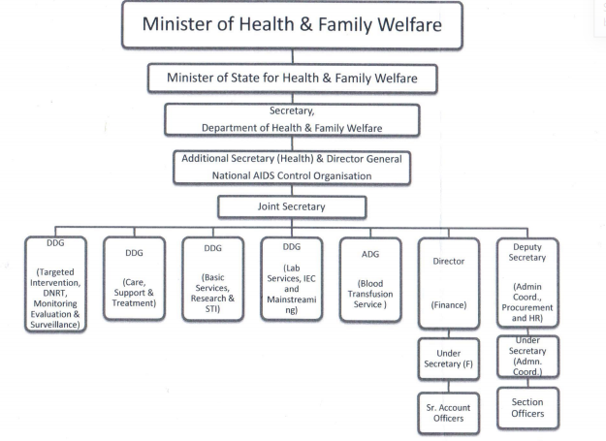
NACO organizational structure
NACO
State AIDS Control Society
District AIDS prevention and control Units
Divisions in NACO

Slide 23
Intersections with other health departments
PPTCT, RTI-STI
RMNCH+A program
HIV-TB co-morbidity
RNTCP
Nutritional and infectious component of HIV
Hep-B,
Immunization programs

Slide 24
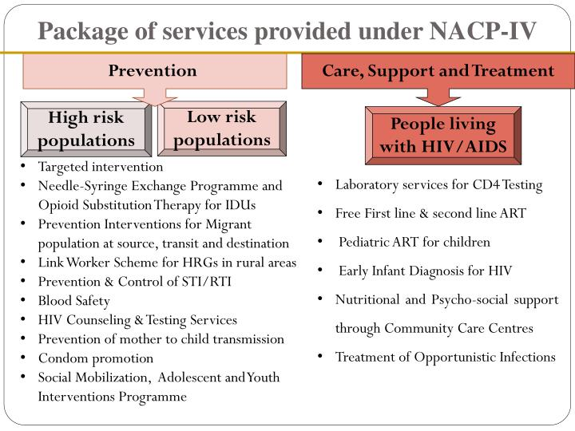
Service delivery
Notes:
1,

Slide 25
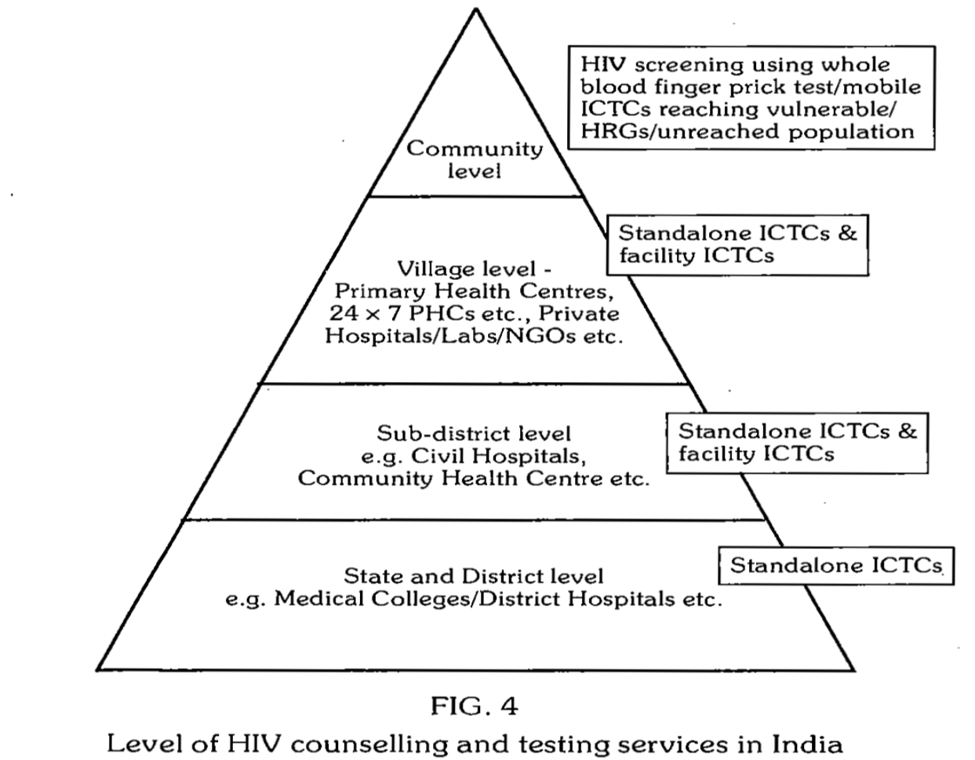
Infrastructure
Park textbook of Preventive and Social medicine, 22nd edition

Slide 26
The HIV testing, counseling and treatment services
Integrated Counseling and Testing Centres (ICTC)
-Fixed facility ICTC – standalone ICTC & Facilities ICTC
-Mobile ICTC
Prevention of parent –to – child transmission of HIV (PPTCT): Integration with RCH program
3. HIV/tuberculosis collaborative activities (expedite the early detection of HIV within 2-4wks of TB positivity)
4. Nodal ART centres-LART centres-LAC plus centres
R&D initiatives: Labs For Life (L4L) Project- Baseline assessment was done to understand the existing laboratory practices, identify areas of gaps/deficiencies, emerging challenges, document best practices, and to decide on the strategies and interventions for implementing quality management systems.
Notes:
2.The PPTCT services provide access to all pregnant women for HIV diagnostic, prevention, care and treatment services. The key goal is to ensure the integrated PPTCT service delivery with the existing RCH programme. 3. NACP and RNTCP have jointly decided to offer HIV testing during the evaluation of pt wid TB, Pt wid TB symptom-this activity expedite the early detection of HIV within 2-4v weeks of TB positivity, hence reduce the mortality.
4. LART and LAC plus centre service facility closer to home for • ARV drugs Link ART Centre • Adherence monitoring and support • Treatment of minor OIs

Slide 27
Services provided
First line ART
Alternative first line ART
Second line ART
Third line ART introduced in 2014
National pediatric HIV/AIDS initiatives
Pediatric second line ART
Early Infant diagnosis
Notes:
.To make the treatment services more accessible to PLHIV, it was decided to set up Link ART Centers located mainly at ICTC in the district /sub- district level hospitals/CHCs nearer to the patient‟s residence and linked to a Nodal ART center within accessible distance.
Monitoring of PLHIV on ART OI Treatment and Prophylaxis HIV TB co infection Psycho-social Function Important slide Psycho-social Function
Tracing LFU and Missed Clients (Pre-ART & on ART) Pre-ART Management through those centres designated as LAC Plus

Slide 28
Information system
Strategic Information Management Unit
A team of IT expert have been deployed at NACO for the maintenance and implementation of on going updates and bug/issues .
IT application of NACO – PALS (PLHIV ART linkage system), IMS ( Inventory management system), MSDS ( migrant service delivery system) and excel based analytical tool for core group at NGO TI)
NDAP( National data analysis plan) – to address the evidence gaps in the programme
Strong HIV sentinel surveillance
Human Resources:
Primary care: 60,000 FLWs including outreach workers, peer educators
Meidcal officers at ART centres, Link ART centre, STI Clinic doctors, Paramedical staff, counsellors
Program leaders: Programme Managers, M&E Officers, ICTC Supervisors, Counselors, Targeted Intervention staff, ART Research Officers, NRHM State and District Programme Officers, Link workers
Source -http://naco.gov.in/sites/default/files/Paving%20the%20Way%20for%20an%20AIDS%2015122017.pdf
Notes:
-the application involves digitalization of data and to keep records of clients on large scale to track client at the individual level and involves transparency in the program- at all level N/S/D/SD --- (and to make the best use of available data- NDAP). It will be implemented from across 35 states from 1208 sentinel sites.

Slide 29
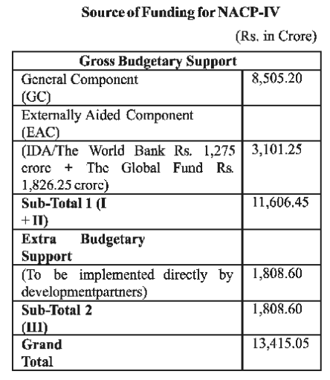
NACP-I
Government share: 45%
NACP-II
Governments share: 9%
NACP-III
share: 25%
NACP-IV
Governments share: 70%
Finance
Source: NACO annual report 2016-2017
Notes:
Around 14,000 crore
https://www.downtoearth.org.in/news/centre-to-bear-most-of-the-expenses-on-aids-control-programme-43497

Slide 30
Supply
Main items include test kits HIV Rapid, ELISA, HBsAg Rapid, ELISA, HCV Rapid, ELISA, RPR Kits, STIL Drug kits, blood bags, equipment (CD4 machines and Blood Bank equipment are centrally procured and supplied to the peripheral units and SACS.
Expenditure remain around 300-500 crore.
Drug, diagnostic kits, equipment are procured through pooled funds largely financed by World Bank.
Materials are indented by NACO and supplied to State AIDS control society.
Supply Chain is aimed to be decentralized but there are issues like stock-outs, under-utilization of IEC, space and computers.
On the other hand, NACO has got greater experience in Supply Chain Management.
NACO annual report 2012-2013
Notes:
funding would be available from domestic budgetary sources and support
from development partners like World Bank, PEPFAR, Global Fund and others. The programme will also
leverage the resources from CSR funds, other ministries and development partners

Slide 31
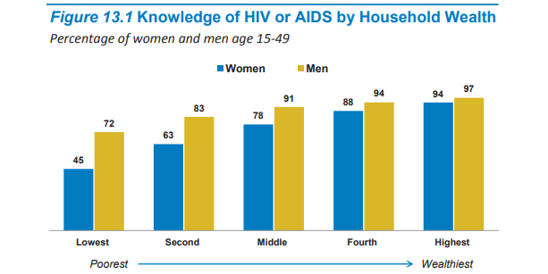
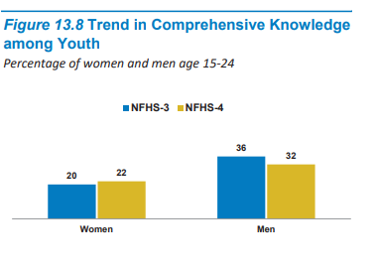
Program coverage in terms of KAP
Only 38.6% of women belonging to scheduled tribe in the age group 15-49 years had heard about AIDS as compared to 55.3 percent of scheduled caste, 58.5 percent other backward castes and 72.7 percent of women from higher castes.
The awareness among Scheduled Tribe men in the same age group though was higher (63.9%) than women, was substantially lower as compared to other caste groups (Scheduled Caste: 80.8%; Other Backward Caste: 84.1%; and Other castes: 89.6%).
Source –
NFHS-IV fact sheet
Researching Evidences on Prevalence of HIV/AIDS among Tribal People in India Ranjana Saradhi, Seema Kaul, and Mukesh Chawla ORG Centre for Social Research
Notes:
This entails extension of interventions to populations that are vulnerable to HIV such as the Tribal people and socially disadvantaged sections of the population in both rural and urban areas. This necessitated undertaking a rural risk/vulnerability assessment and a Social Assessment of HIV/AIDS among Tribal People in India.3 The Social Assessment among Tribal People documented the prevalence and risk of HIV/AIDS among tribal people, their levels of knowledge, social and behavioural causes and consequences of HIV/AIDS (including stigma), and strategies used for prevention, diagnosis, treatment and care (PDTC) of HIV/AIDS in order to ensure appropriate programme design and implementation to reduce the spread of HIV/AIDS and improve its management. Primary data collection, review of existing literature and programmes, consultation with stakeholders and development of Tribal Action Plan was an integral part of the assessment.

Slide 32
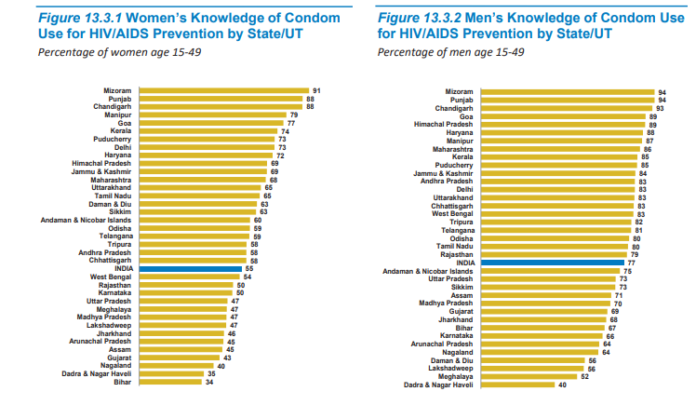
Source –
NFHS-IV fact sheet

Slide 33
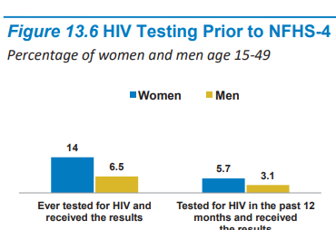
Diagnostic and treatment coverage
Source –
NFHS-IV fact sheet http://naco.gov.in/sites/default/files/Paving%20the%20Way%20for%20an%20AIDS%2015122017.pdf

Slide 34
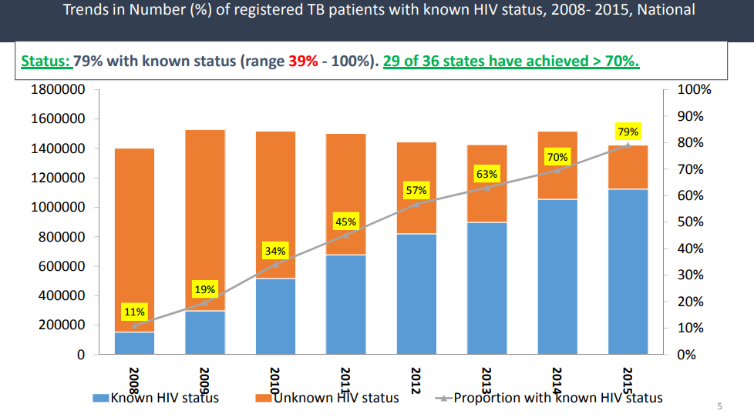
Care, Support and Treatment & HIV-TB DR R S GUPTA DDG (BTS & CST) NACO, MOHFW, GOI, NEW DELHI
Notes:
Care, Support and Treatment & HIV-TB DR R S GUPTA DDG (BTS & CST) NACO, MOHFW, GOI, NEW DELHI

Slide 35
Costs associated with HIV/AIDS
Systems’ perspective
CD4 count monitoring is $25 per test
Viral load $100 per test.
In 1998, the cost of first line ART in India was Rs. 25,000 (US$658) per patient per month; by 2005 the monthly cost had dropped dramatically to Rs. 1,000
End users’ perspective
OOPE:
49% of the total Household expenditure
Studies in India examining patient health-seeking behaviours and practices have shown that the most common barrier to complete adherence was cost32
Financial burden of health services for people with HIV/AIDS in India
N. Kumarasamy, K.K. Venkatesh*, K.H. Mayer* & Kenneth Freedberg**
Indian J Med Res 126, December 2007, pg 509-517

Slide 36
Program achievements NACP I (1992-1999)
❑ National AIDS response structures at both the national and state levels
and provided critical financing.
❑ Strong partnership with the World Health Organisation (WHO) and later
helped mobilize additional donor resources.
❑ Established the State AIDS Control Cells
❑ Improved blood safety.
❑ Expanded sentinel surveillance and improved coverage and reliability of
data.
❑ Improved condom promotion activities.
❑ National HIV testing policy.
Notes:
NACP-I OBJECTIVE
❑ Slow and prevent the spread of HIV through a major effort to
prevent HIV transmission.
KEY STRATEGIES
Focus on raising awareness, Blood safety, Prevention among
high-risk populations,
❑ Improving surveillance

Slide 37
NACP II (1999-2007)
At the operational level NGOs implemented & 1,033
targeted interventions set up, 875 Voluntary counseling and
testing centers (VCTC) and 679 STI clinics at the district
level.
❑ Nation-wide and state level Behaviour Sentinel Surveillance
(BSS) surveys were conducted
❑ Prevention of parent-to-child transmission (PPTCT)
programme was expanded.
❑ A computerized management information system (CMIS)
created.
❑ HIV prevention and care and support organizations and
networks were strengthened.
❑ Support from bilateral, multilateral, and other partner
agencies also increased substantially

Slide 38
NACP-III (2007-2012)
❑ There are 306 fully functional ART Centres against the target of 250
by March 2012
❑ Nearly 12.5 lakh PLHIV are registered and 420000 patients are
currently on ART.
❑ 612 Link ART Centre (LAC) have been established wherein, 26023
PLHIV are taking Services
❑ There are 10 Centres of Excellence,
❑ 7 Regional Pediatric centres are also functional.
❑ 259 Community Care Centres across the Country
❑ 6000 condoms & 6000 village information centres established
❑ 3000 Red ribbon clubs established
❑ Link Workers training module updated
Notes:
STRATEGIES
❑ Prevention – Targeted intervention (TI), ICTC, blood safety,
communication, advocacy and mobilisation, condom promotion.
❑ Care, support and treatment – ART, Pediatric ART, Center for
excellence, Community Care Centers.
❑ Capacity building – establishment, support and capacity
strengthening, training, managing programme implementation and
contracts, mainstreaming/private sector partnerships.
❑ Strategic information management – monitoring and evaluation.

Slide 39
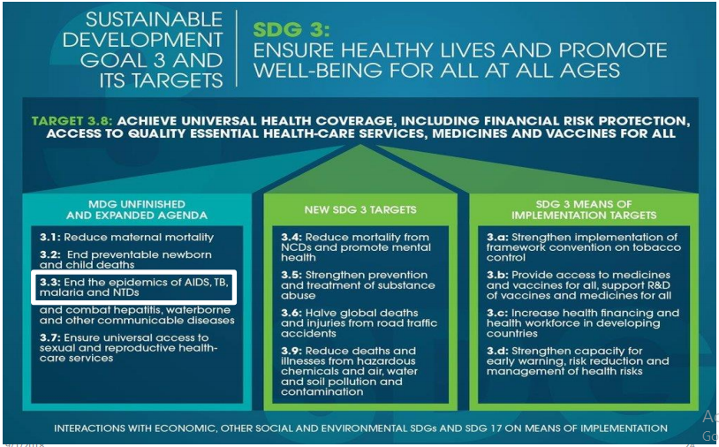
NACP IV (2012-2017) Marching towards Sustainable Development Goals
The global vision and sustainable development goal is to end AIDS by 2030 requires initiating all PLHIV on ART irrespective of CD4 cell count as per the 2015 WHO ART guidelines.
Notes:
SDG

Slide 40
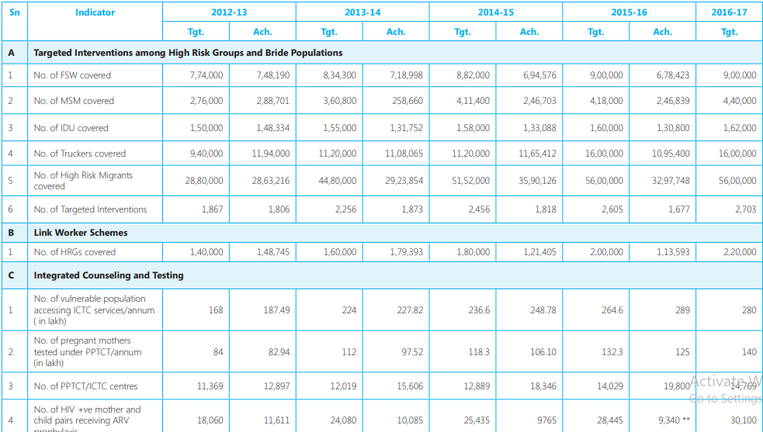
Achievements

Slide 41
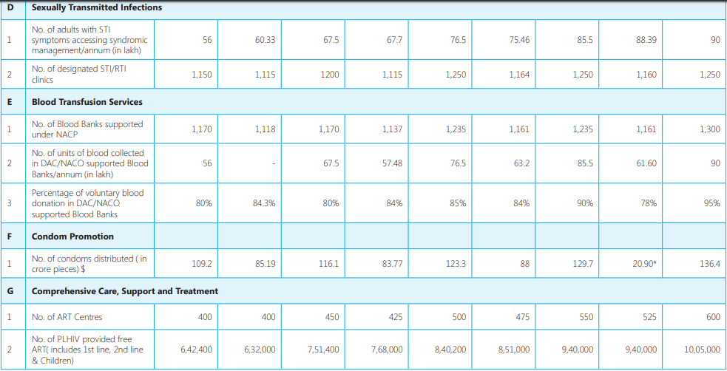

Slide 42
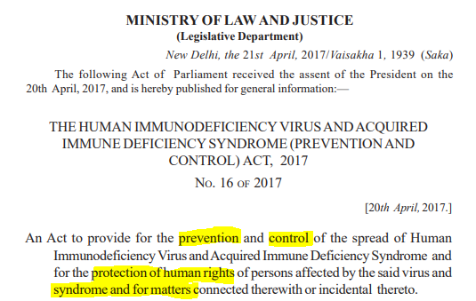
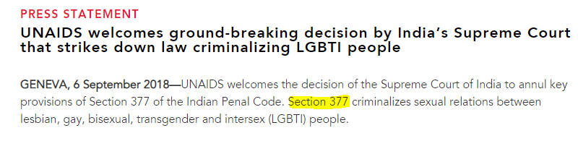
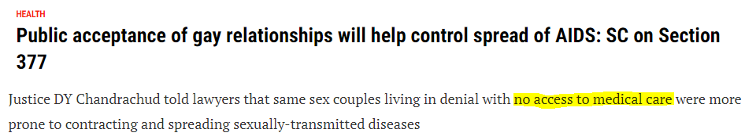
Legal perspective on HIV-AIDS and NACP
Notes:
Informed consent, discrimination, HIV status disclosure, obligation to keep records (establishments), welfare

Slide 43
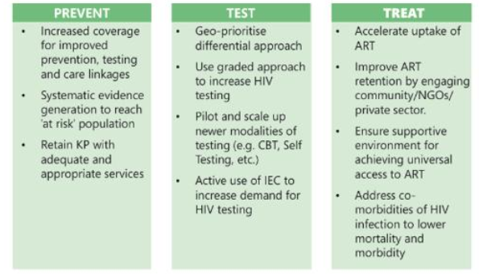
National Strategic Plan 2017-2024

Slide 44
‘Three Zeros’ - i.e. zero new infections, zero AIDS-related deaths and zero discrimination
By 2020, the focus of the national programme will be on achieving the following fast track targets:
(i) 75% reduction in new HIV infections
(ii) 90-90-90: 90% of those who are HIV positive in the country know their status, 90% of those who know their status are on treatment and 90% of those who are on treatment experience effective viral load suppression
(iii) Elimination of mother-to-child transmission of HIV and Syphilis, and
(iv) Elimination of stigma and discrimination
By 2024, the further achievements envisaged are:
(i) 80% reduction in new HIV infections,
(ii) Ensuring that 95% of those who are HIV positive in the country know their status, 95% of those who know their status are on treatment and 95% of those who are on treatment experience effective viral load suppression

Slide 45
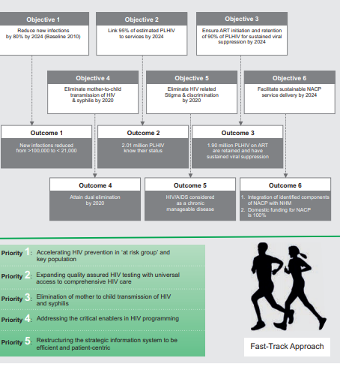

Slide 46
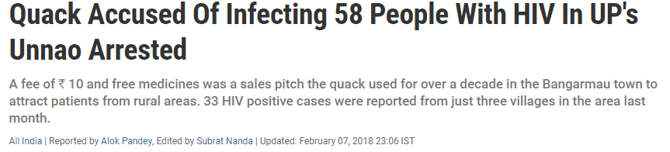
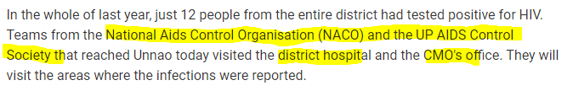
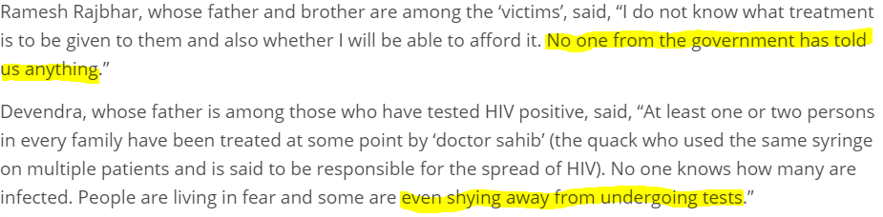
Existing challenges
Notes:
https://www.livemint.com/Politics/BTI3nzuFrd1NOxb75dYrmJ/Red-tape-on-grant-delayed-care-for-HIV-patients-says-Global.html

Slide 47
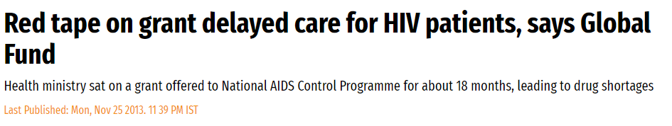
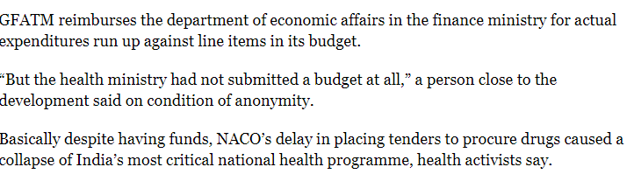
https://www.livemint.com/Politics/BTI3nzuFrd1NOxb75dYrmJ/Red-tape-on-grant-delayed-care-for-HIV-patients-says-Global.html

Slide 48
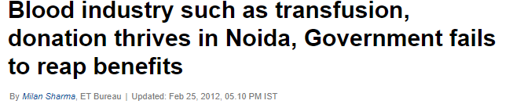
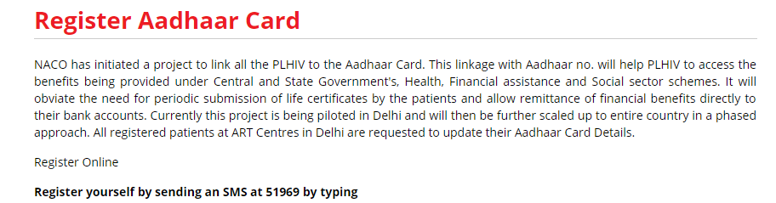
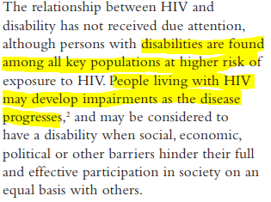
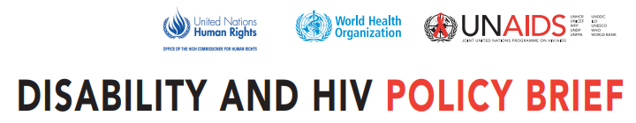
Notes:
Aadhar DISCLOSURE OF HIV STATUS 8. (1) Notwithstanding anything contained in any other law for the time being in force,— (i) no person shall be compelled to disclose his HIV status except by an order of the court that the disclosure of such information is necessary in the interest of justice for the determination of issues in the matter before it;

Slide 49
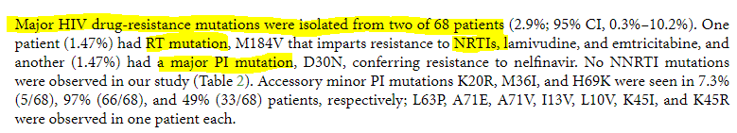
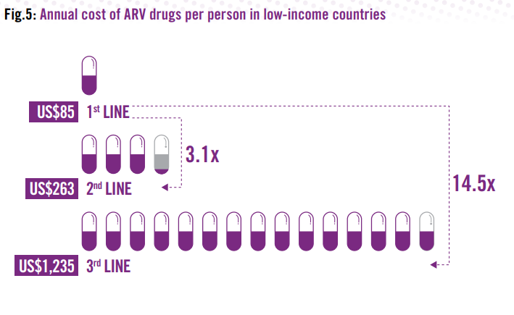
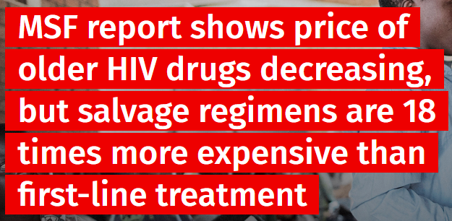
Emerging issues
AIDS Research and Treatment Volume 2012, Article ID 905823, 6 pages http://dx.doi.org/10.1155/2012/905823Research Article
Prevalence of HIV Drug Resistance Mutations in HIV Type 1 Isolates in Antiretroviral Therapy Naïve Population from Northern India
S. Sinha,¹ H. Ahmad,² R. C. Shekhar,¹ N. Kumar,¹ L. Dar,² J. C. Samantaray,² S. K. Sharma,¹ A. Bhargava,¹ R. M. Pandey,³ R. L. Mitsuyasu,⁴ and J. L. Fahey⁵
Notes:
https://msfaccess.org/msf-report-shows-price-older-hiv-drugs-decreasing-salvage-regimens-are-18-times-more-expensive
oday, the lowest available price for a quality-assured, World Health Organization-recommended first-line one-pill-a-day combination is US$100 per person per year (tenofovir/emtricitabine/efavirenz). This is a decrease of 26% since MSF last recorded the lowest price for first-line treatment at $136 in 2014. For a WHO-recommended second-line regimen, the lowest available price is now $286 per person per year (zidovudine/lamivudine + atazanavir/ritonavir)—an 11% decrease from $322 two years ago.
These prices continue to fall as a result of robust competition among generics manufacturers in key producing countries, primarily India. But the price of newer drugs—needed for people who have run out of other HIV treatment options—remain high, largely because of patent monopolies held by drug corporations. The lowest price for salvage treatment today is $1,859 per person per year (raltegravir + darunavir/ritonavir + etravirine). This is more than 18 times the price of first-line therapy, and more than six times the price of today’s most affordable second-line combination. The price for this combination has come down only by seven percent, from $2,006 per year in 2014. These are the lowest global prices, but many countries, especially ‘middle-income’ countries, pay much higher prices for these medicines because pharmaceutical patents block them from using generics.

Slide 50
HIV resistance
WHO GLOBAL ACTION PLAN ON HIV DRUG RESISTANCE 2017-2021
Strategic objective 1: Prevention and response Implement high-impact interventions to prevent and respond to HIVDR.
Strategic objective 2: Monitoring and surveillance
Strategic objective 3: Research and innovation
Strategic objective 4: Laboratory capacity
Strategic objective 5: Governance and enabling mechanisms
Notes:
HIV resitance: Acquired HIVDR (ADR)
Transmitted HIVDR (TDR)
Pretreatment HIVDR (PDR)

Slide 51
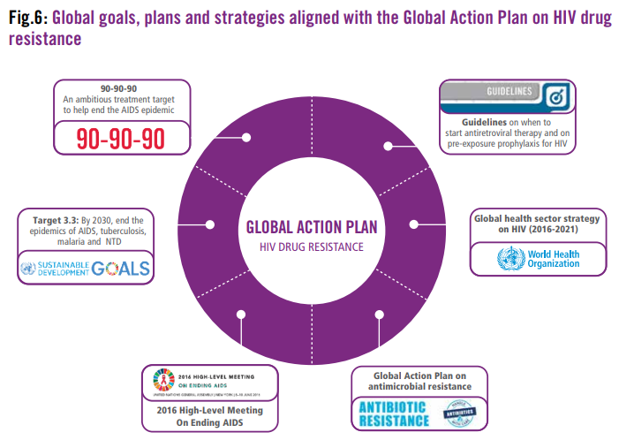

Slide 52
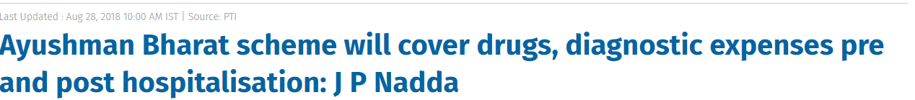
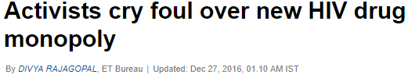
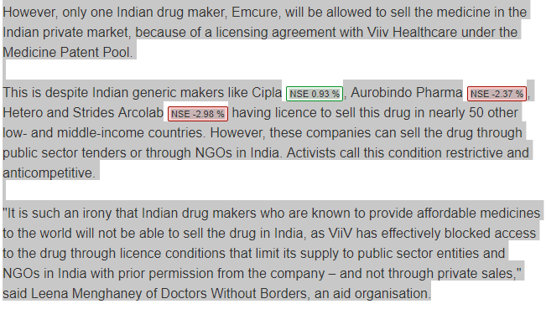
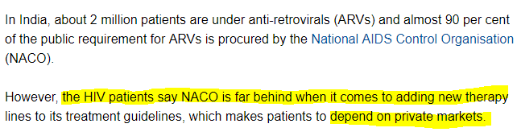
Pradhan Mantri Jan Aarogya Yojana
Notes:
Dolutegravir — sold by GlaxoSmithKline's Viiv Healthcare unit under the Trivicay brand — is considered the best-in-class HIV drug as it reduces virus levels faster and has a high barrier to resistance compared to previous line of drugs. However, only one Indian drug maker, Emcure, will be allowed to sell the medicine in the Indian private market, because of a licensing agreement with Viiv Healthcare under the Medicine Patent Pool. This is despite Indian generic makers like CiplaNSE 0.93 %, Aurobindo PharmaNSE -2.37 %, Hetero and Strides ArcolabNSE -2.98 % having licence to sell this drug in nearly 50 other low- .. Read more at: //economictimes.indiatimes.com/articleshow/56191981.cms?utm_source=contentofinterest&utm_medium=text&utm_campaign=cppst

Slide 53
Global strategies and projections for 2030
Critical Areas For Fast-track Action
Bolstering combination prevention with new tools
Ensuring all people living with HIV know their status
Expanding quality treatment for all people living with HIV
Keeping people healthy and alive through
person-centred and holistic care
Reaching and protecting those most vulnerable and
at risk.
Source- Global health sector strategy on HIV 2016-2017 towards ending AIDS

Slide 54
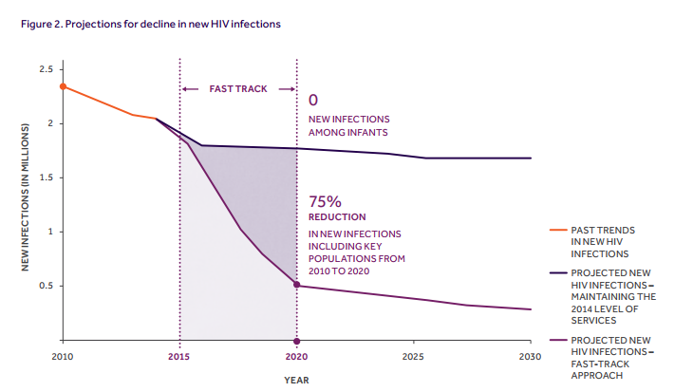

Slide 55
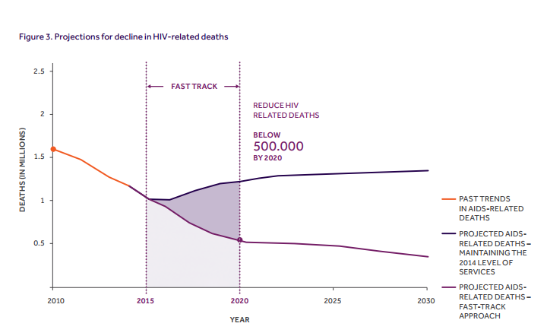

Slide 56
Journal paper recom

Slide 57
Supply | Service delivery | HR | Finance
Access to affordable second and third line drugs | Community engagement and comprehensive sex-education | Develop HR capacity under Training centres for drug adherence issues, long-term care
Prompt revision of drug regimen | Inclusive and tailor-made services for tribal population, PwD, LGBTQIA+ Community | Strategic and deliberate inclusion of Rehabilitation workers
 | Continuum of care within CST component | Periodic training of a cadre of LW to deal with the condition in high prevalence districts
 |  | Curb quackery by collaborating with NGOs to identify and educate
Notes:
https://www.youthkiawaaz.com/2016/08/aids-
http://www.naco.gov.in/sites/default/files/CST_Key%20Recommendations.pdf
funds-shortage-and-delay/

Slide 58
References
Solomon et al (2004) A review of the HIV epidemic in India
Mid-Term Appraisal of National AIDS Control Programme (Phase IV), MoHFW, 2016
NACO annual report 2016-2017
The Evolution Of Nacp: India's Attempt At Controlling The Hiv/ Aids Epidemic 7(1):7-9 · January 2018

Slide 59
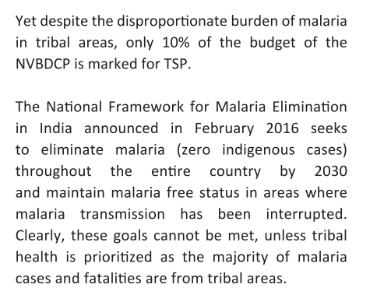
ORISSA, JH, CHHATT- FALCIPARUM CASES HIGH: 5% POP BUT 44% OF BURDEN

Slide 60
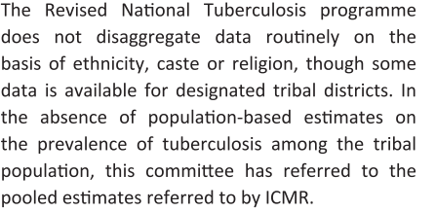
RNTCP

Slide 61
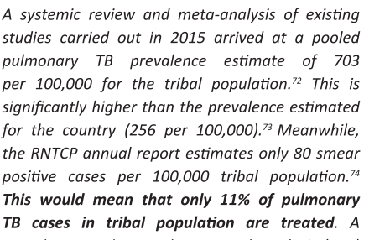
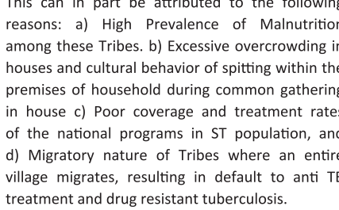
Sahariya tribes- High some low

Slide 62
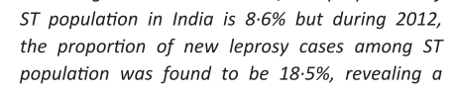
Maternal Health
JSY- 1400/700 very low
Leprosy

Slide 63
Integrated Tribal Development Project. The Programme on Integrated Tribal Development Projects (ITDP) under Tribal Sub-Plan (TSP) is being implemtnted since the Fifth Five Year Plan with specific objectives of reducing poverty, improving educational status an eliminating exploitation of the tribal families.
he Fifth Plan (1974-78)marked a shift in approach as reflected in thelaunching of the Tribal Sub-Plan (TSP) for the directbenefit of the development of tribals. The TSPstipulated that funds of the centre and the statesshould be quantified on the population proportionbasis with budgetary mechanisms to ensureaccountability, non-divertability and utilisation for thewelfare and development of STs

Slide 64
Amongst the tribals, PTGs and thenomadic groups are passing through the mostfragile health conditions, when compared to theothers. Therefore, a new Scheme called ‘Medicalcare for Remote and Marginalised and NomadicCommunities’ was launched during the Ninth FiveYear Plan with an approved outlay of Rs.5 crore.Under this Scheme, the following projects weretaken up towards –
i) Prevention and control ofHepatitis ‘B’ infection amongst the PTGs ofAndaman & Nicobar Islands;
ii) Intervention forhereditary common haemolytic disorders amongsttribals of Sundergarh district in Orissa;
iii)Intervention programme for Cholera andParasiptism, Vitamin ‘A’ deficiency disorders amongsome PTGs of Orissa; and
iv) Interventionprogramme for Nutritional Anaemia andHaemoglobinopathies amongst primitive tribalpopulation.
For the exclusive benefit of the backwardtribal dominant districts of Orissa viz. Kalahandi, olangir and Koraput, a long term Action Plan wastaken up rigorously with the aim of pooling theavailable resources and integrating themscientifically for speedy development. Health hasbeen an important activity in this area and in orderto provide immediate relief to tribals at the door-steps, 53 mobile Health units have been functioning.

Slide 65
Nipah
Influenza h5n1 avian; h1n1 swine flu
SARS CORONA virus
Ebola virus
Novel corona virus
Re-emerging
Cholera
Dengue
Polio
TB
Rabies

Slide 66
HOST
Personal hygiene
Plague 2002 Shimla---- existence of sylvatic foci of Plague in several areas
Immunity
HIV/AIDS
Nutrition
Tuberculosis
Travel
Acquiring of new pathogen and then brining it in a new geo area: h1n1 2009 in Hyderabad
Population density/ overcrowding
Person to person spread: nipah virus siliguri 2001, 2018
Access to safe water and infrastructure
Poor housing, sani: Cholera O139 Chennai 1992
Occupation:
Farmers to Crimean Congo Hemorrhagic fever- living in endemic areas, animal handlers-person to person spread
Human behavior:

Slide 67
AGENT
Genetic change- evolution: microbial adaption and change
Insecticide and AB resitance
Resistant genes get passed on

Slide 68
ENVIRONMENT
Climate change (ecological disruption)
ED and human intrusion into new eco system increases exposure of agents specially in tropic countries (hot spots)
CC also shifts the ecological niche of disease
e.g. Re-occurence of Plague due to spillover from epizootic cycle of plague in wild rodents to commensal rodents due to climate variation
Urbanization and deforestation
Impact transmission patterns, scope of the disease and change in behaviours
e.g. Dengue in 2006 Delhi
Catastrophic event
e.g. Floods and leptospirosis 2018 Kerala
Occupational practices of geographic areas
Chandipura virus in rural area spread by sandfly in 2003 (acute encephalitis) Gujarat
Technology and industry:
Food processing industry, animal industry
AMR: Water contaminated with drug resistant bacteria sprayed on crops, sepsis being a problem among children, animal - multi drug resistant Salmonella typhi infection

Slide 69
Strengthening surveillance:
State level epi units
Network of epis and micros at statedistrict video conferencing
Complying to IHR
At the time of SARS only YF Plague and cholera was required but not now
Building capacity in Epi
Field epi training programs at D,S,N levels long and short term; in service training by NIE. Epi Intelligence services-mentorship driven training program by
Strengthen Labs

Slide 70
R and D
Key policy decision based on evidence in areas of rational use of drug and pesticide, environmental impact. Climate change
Technical Support with IDENTIFICATION OF AGENET, DEVELOPMENT OF DIAGNOSTIC TESTS, FORMULATION OF CASE MANAGEMENT, PREVENTIVE STARTEGIES, ESTABLISHMENT OF LABS TO HANDLE NEW AND EXOTIC ORGANISM

Slide 71
Information sharing
H1N1 Pandemic GOARN

